Slide 1
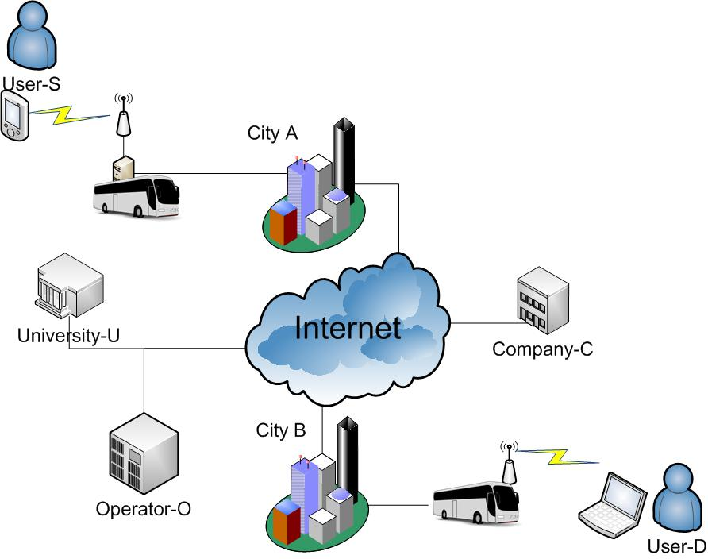
Extending Internet Infrastructure with DTNs
Lefteris Mamatas
Space Internetworking Center
emamatas@gmail.com

Slide 2
Presentation Outline
Introduction
Example environment
Modeling considerations
Routing mechanisms
Conclusions

Slide 3
Introduction
Research on DTNs focuses mainly on homogeneous networks
DTNs can extend/bridge infrastructure networks
in areas where connectivity is absent or problematic
Infrastructure could support mobile communication:
Mobiles could offload resources to infrastructure

Slide 4
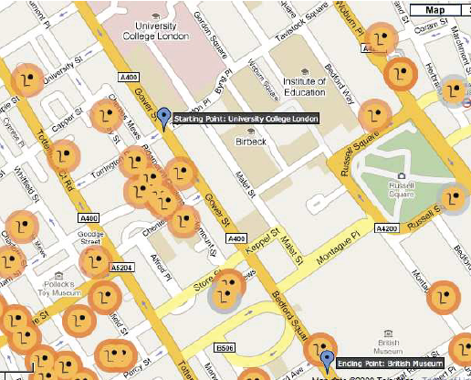
Example environment: Mobile nodes & Home Access Points (HAPs)

Slide 5
DTNs & Infrastructure
Routing protocols
Conventional (e.g., RIP, OSPF)
For mobile / ad-hoc (e.g., DSR, AODV)
For DTNs (e.g., epidemic, spray ‘n focus)
All three categories of proposals usually follow parallel paths.
We are studying the continuum between DTNs and infrastructure.
DTNs are extending Internet infrastructure
Storage can be supported from access points
A part of the path could be established before data is sent and another opportunistically.

Slide 6
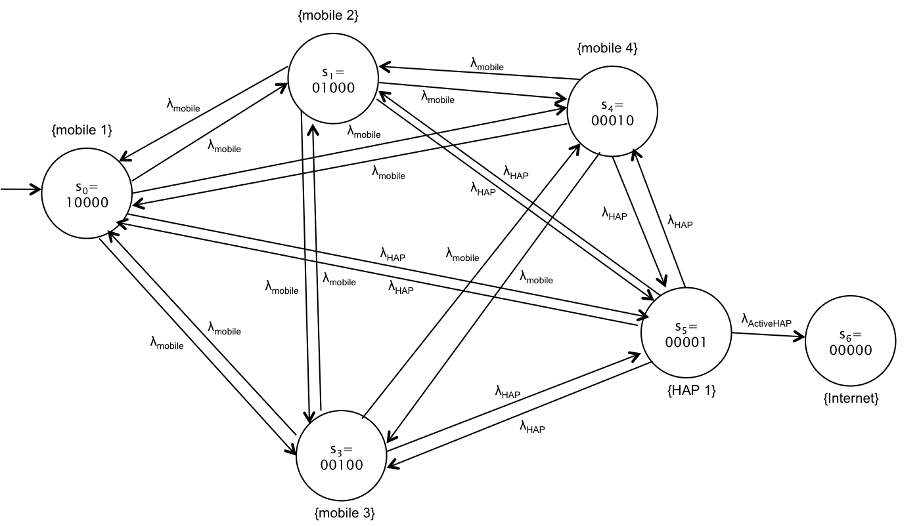
Modeling Considerations

Slide 7
Inter-contact times: Quantifying connectivity opportunities
Time passed since previous exit until next entry into the radio range
The inter-contact times between individual node pairs is usually approximated as exponentially distribution
The aggregate distribution is confused in the literature with the individual node pair distribution.
It is a mixture of the individual pairs distribution
What is the relation between:
Individual node pairs distribution
Aggregate distributions of mobiles only
Aggregate distributions of mobiles and infrastructure nodes (HAPs)

Slide 8
CCDF of aggregated inter-contact times
The aggregated distribution is:
a mixture of individual pairs distributions F_{λ}(x)
weighted by the rates of individual pairs (density f(λ))
Only heterogeneity in rates is considered and not in distributions of rates or inter-contact times.

Slide 9
Aggregated Inter-contact Times Distributions
Scenario with 10 mobile nodes and 113 HAPs
Heterogeneity is reflected to the different distributions
Contacts | All | Between Mobiles | Between Mobiles & HAPs
Distribution | Power law | Exponential | Power law

Slide 10
Pairs inter-contact rates (reciprocal of the averages)
Scenario with 10 mobile nodes and 113 HAPs
Rates of the pairs inter-contact times is usually exponential, but not always
Breaking down the formula to the different groupings of contacts, improves its accuracy
Contacts | All | Between Mobiles | Between Mobiles & HAPs
Distribution | Exponential | Unknown | Exponential

Slide 11
Physical meaning of distributions
Power-law means infinite expected delay
Exponential means finite expected delay
The asymptotic behavior determines the convergence properties of forwarding algorithms
A heavy-tail means individual pairs with inter-contact rates arbitrarily close to 0
(nodes with zero probability to meet)
Increasing the number of HAPs resulted in an exponential cut-off

Slide 12
Modeling Scenario: Hybrid network (UPNs + DTNs)
m nodes are mobile and N nodes static (HAPs)
The first mobile node has the data to be forwarded to the Internet
through an active HAP
HAPs may be active or inactive
inactive HAP may keep data in the storage until they are active or a mobile passes by
We consider as state the nodes having the data

Slide 13
Our model
Continuous-time Markov Chains (CTMC) model
Delays (between contacts-state changes) are exponentially distributed
Discrete states
Continuous time-steps
We are working on a semi-markov model with heterogeneous properties
reflecting different distributions in delays.
We improve the expressiveness of the theoretical tool to match better the studied environment.

Slide 14
Example CTMC State diagram: First contact Algorithm
{mobile 2}
s₁=
01000
λ_{mobile}
{mobile 4}
λ_{mobile}
s₄=
00010
λ_{mobile}
{mobile 1}
λ_{mobile}
λ_{mobile}
s₀=
10000
λ_{mobile}
λ_{HAP}
λ_{HAP}
λ_{HAP}
λ_{HAP}
λ_{HAP}
λ_{mobile}
λ_{mobile}
λ_{mobile}
λ_{HAP}
λ_{mobile}
s₅=
00001
s₆=
00000
λ_{mobile}
λ_{ActiveHAP}
λ_{mobile}
λ_{HAP}
{HAP 1}
{Internet}
s₃=
00100
λ_{HAP}
{mobile 3}

Slide 15
Transition rates
From a mobile to mobile:
From a mobile to a HAP (depends on the HAPs positions):
From a HAP to the Internet (the HAP is active)
the user is out of home and leaves his connection open
reflects average surfing-time

Slide 16
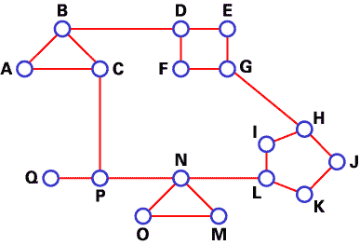
Hybrid routing mechanisms

Slide 17
Routing mechanisms
A routing mechanism:
Should tune involved trade-offs based on the type of node, e.g.,
Mobiles may offload resources to HAPs
Storage could be traded for communication overhead
Should follow appropriate tactics to each node type, e.g.,
Leaving redundant information to HAPs
Mobiles should forward data to nodes having a good chance to meet a HAP

Slide 18
Routing mechanisms
Epidemic in HAPs
We tested a hybrid protocol that uses epidemic routing in HAPs only.
Routing protocol for UPNs
Spray ‘n focus produced good results in the homogeneous setting
We kept the “spraying” phase as it is and extended the “focus” phase with an inter-contact time estimation mechanism.
Based our analysis, the inter-contact time distribution between a mobile node and infrastructure is exponential.
Using curve-fitting, we define the rate λ for each mobile node.
This exponential function estimates the future possibility to contact a HAP (i.e., any HAP).

Slide 19
Trading Storage in Mobiles for Communication cost

Slide 20
Only mobiles are affected

Slide 21
Routing protocol for UPNs

Slide 22
Conclusions
The DTNs could be seen as a part of the global network jigsaw puzzle:
gradually incorporating challenging environments
DTN protocols should be able to adapt to the properties and resource constraints of each heterogeneous group of nodes.
Theoretical models should be extended along these lines.

